Slide 1
A Poisson Analysis of Formula 1 Pit Stops
Andrew Estes

Slide 2

Continuous Distributions
Discrete Distributions
Discrete uniform distribution: All outcomes are equally likely
Bernoulli Distribution: Single-trial with two possible outcomes
Poisson Distribution: The probability that an event may or may not occur
Gaussian Distribution: Symmetric distribution of values around the mean
Student t-Test Distribution: Small sample size approximation of a normal distribution
Exponential distribution: Model elapsed time between two events
Notes:
https://datasciencedojo.com/blog/types-of-statistical-distributions-in-ml/

Slide 3
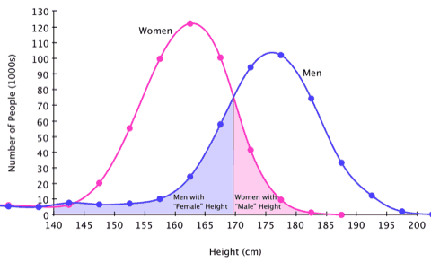
Poisson Distribution Example
Notes:
https://sugarandslugs.wordpress.com/2011/02/13/sex-differences/

Slide 4
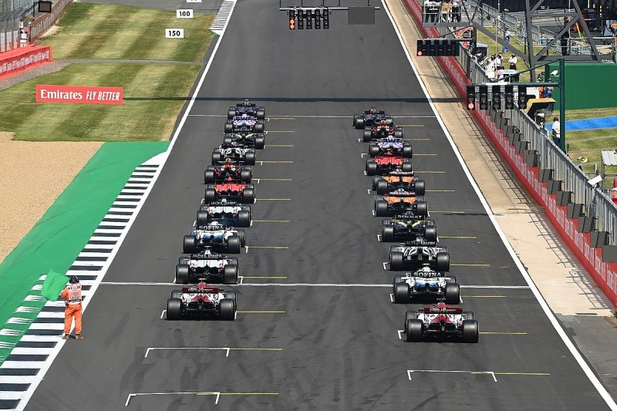
Notes:
Starting formation for the 20 cars, beginning of race

Slide 5
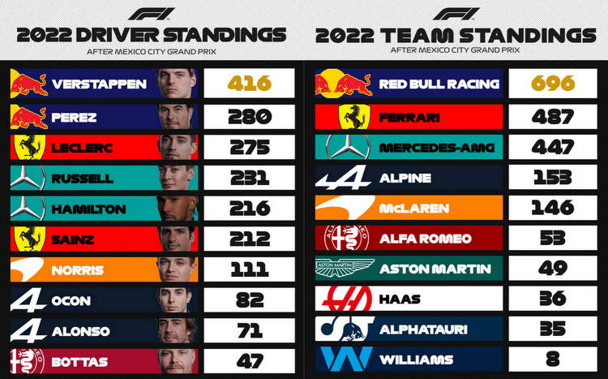

Slide 6
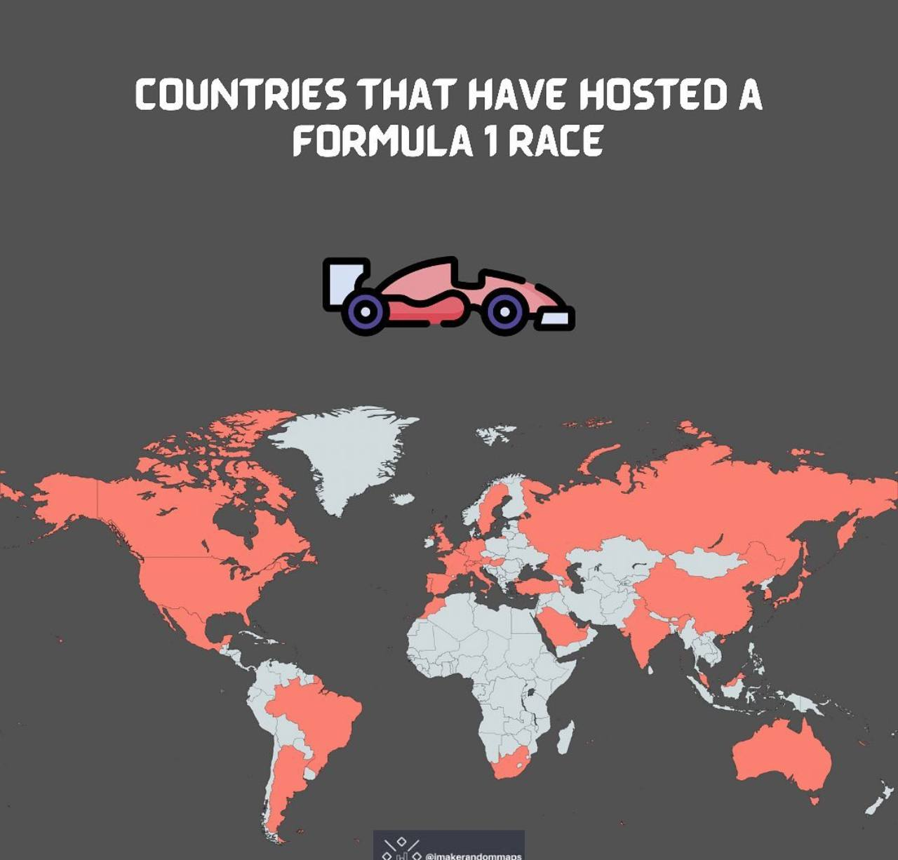

Slide 7
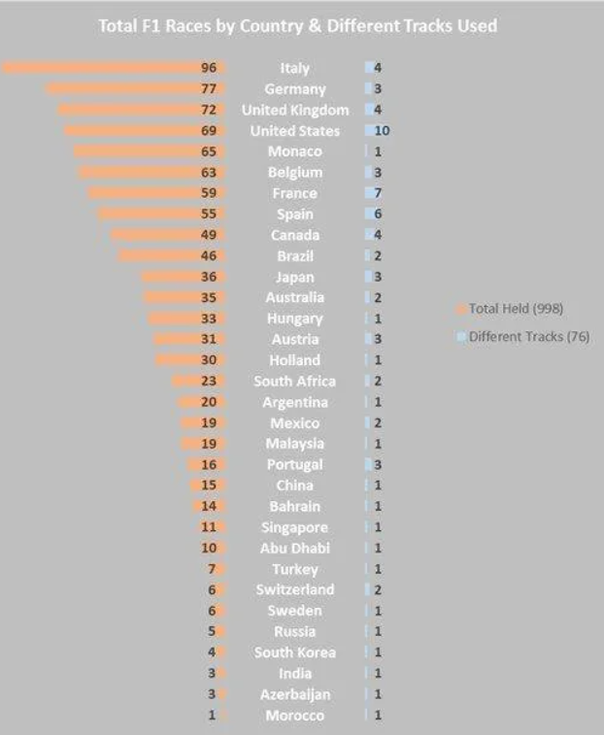

Slide 8
Frequency of Courses Per Year
Course # | Course | 2018 | 2019 | 2020 | 2021 | 2022 | Sub-Total
1 | Abu Dhabi | 0 | 1 | 1 | 1 | 1 | 4
2 | Australia | 1 | 1 | 0 | 0 | 1 | 3
3 | Austria | 1 | 1 | 2 | 2 | 1 | 7
4 | Azerbaijan | 1 | 1 | 0 | 1 | 1 | 4
5 | Bahrain | 1 | 1 | 2 | 1 | 1 | 6
6 | Belgium | 1 | 1 | 1 | 1 | 1 | 5
7 | Brazil | 1 | 1 | 0 | 1 | 1 | 4
8 | Canada | 1 | 1 | 0 | 0 | 1 | 3
9 | China | 1 | 1 | 0 | 0 | 0 | 2
10 | France | 1 | 1 | 0 | 1 | 1 | 4
11 | Germany | 1 | 1 | 1 | 0 | 0 | 3
12 | Great Britain | 1 | 1 | 2 | 1 | 1 | 6
13 | Hungary | 1 | 1 | 1 | 1 | 1 | 5
14 | Italy | 1 | 1 | 3 | 2 | 2 | 9
15 | Japan | 1 | 1 | 0 | 0 | 1 | 3
16 | Mexico | 1 | 1 | 0 | 1 | 1 | 4
17 | Monaco | 1 | 1 | 0 | 1 | 1 | 4
18 | Netherlands | 0 | 0 | 0 | 1 | 1 | 2
19 | Portugal | 0 | 0 | 1 | 1 | 0 | 2
24 | Spain | 1 | 1 | 1 | 1 | 1 | 5
25 | Turkey | 0 | 0 | 1 | 1 | 0 | 2
26 | United Arab Emirates | 1 | 0 | 0 | 0 | 0 | 1
27 | United States | 1 | 1 | 0 | 1 | 2 | 5
 | Sub-Total | 21 | 21 | 17 | 22 | 22 | 103

Slide 9
Climate Variability
 | Air Temperature (Fahrenheit) | Track Temperature (Fahrenheit) | Humidity (%) | Air Pressure (millibar)
Low | 48 | 56.8 | 5 | 779.5
High | 99 | 152.6 | 97.5 | 1023.5
Average | 74.5 | 95.5 | 54.8 | 986.2
Standard Deviation | 41.1 | 49.5 | 18.6 | 49.2

Slide 10
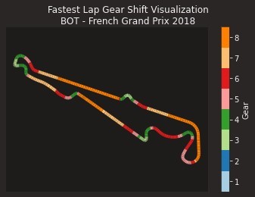
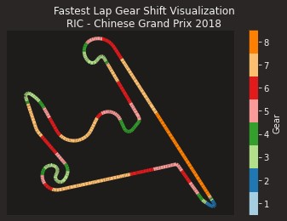
Notes:
Very different course layouts.
Also different geographic areas – North America, Central America, South America, Europe, Middle East, Far East, Australia.

Slide 11
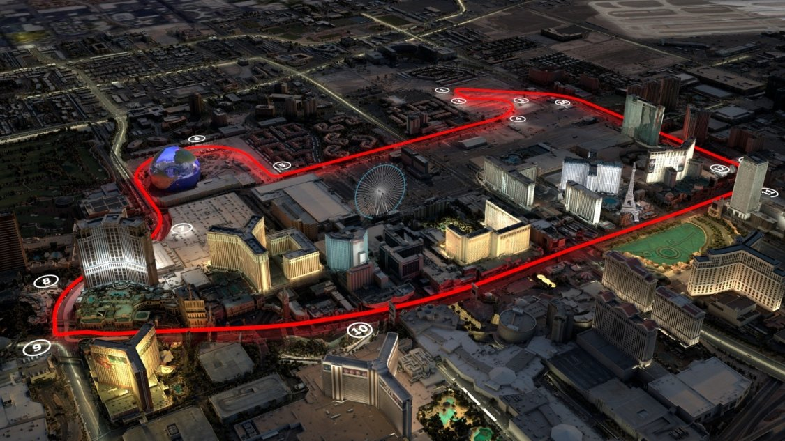
Notes:
Very different course layouts.
Also different geographic areas – North America, Central America, South America, Europe, Middle East, Far East, Australia.

Slide 12
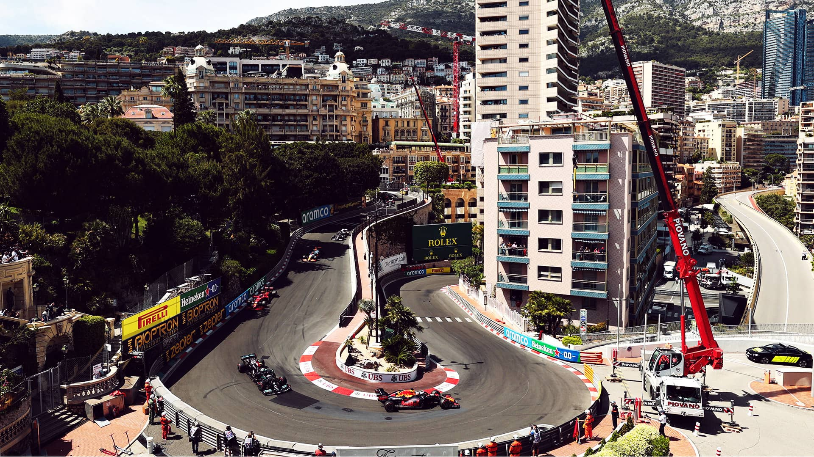
Notes:
In addition to course layout, difference in track vs street. Monaco, here, is on the streets that people use for normal traffic and can include these relatively severe changes in elevation and curves that are not normally found on a race-dedicated track.

Slide 13
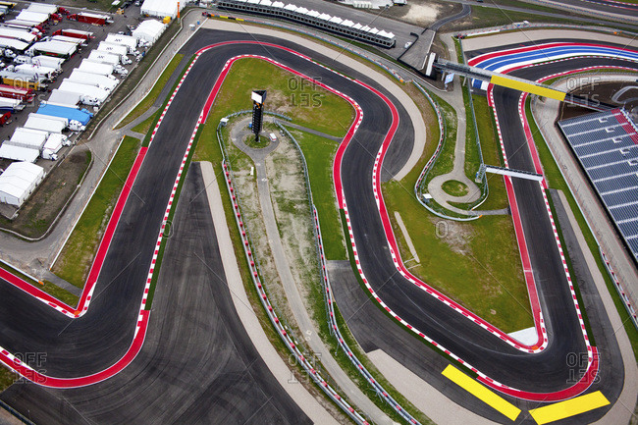

Slide 14
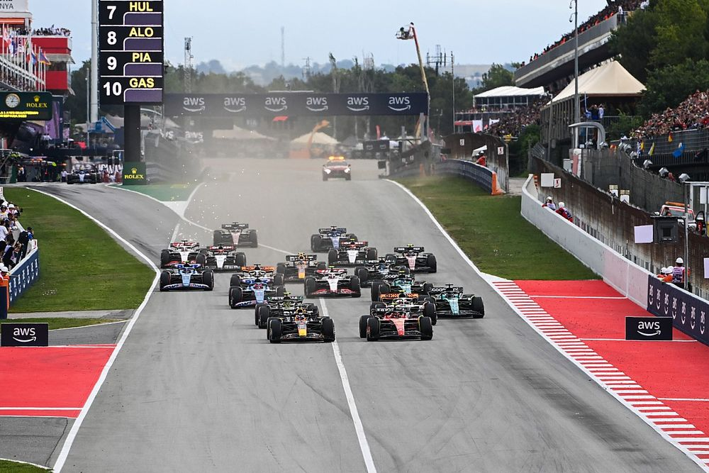
Notes:
A different view of the starting lap that shows the pit lane to the left side of the picture

Slide 15
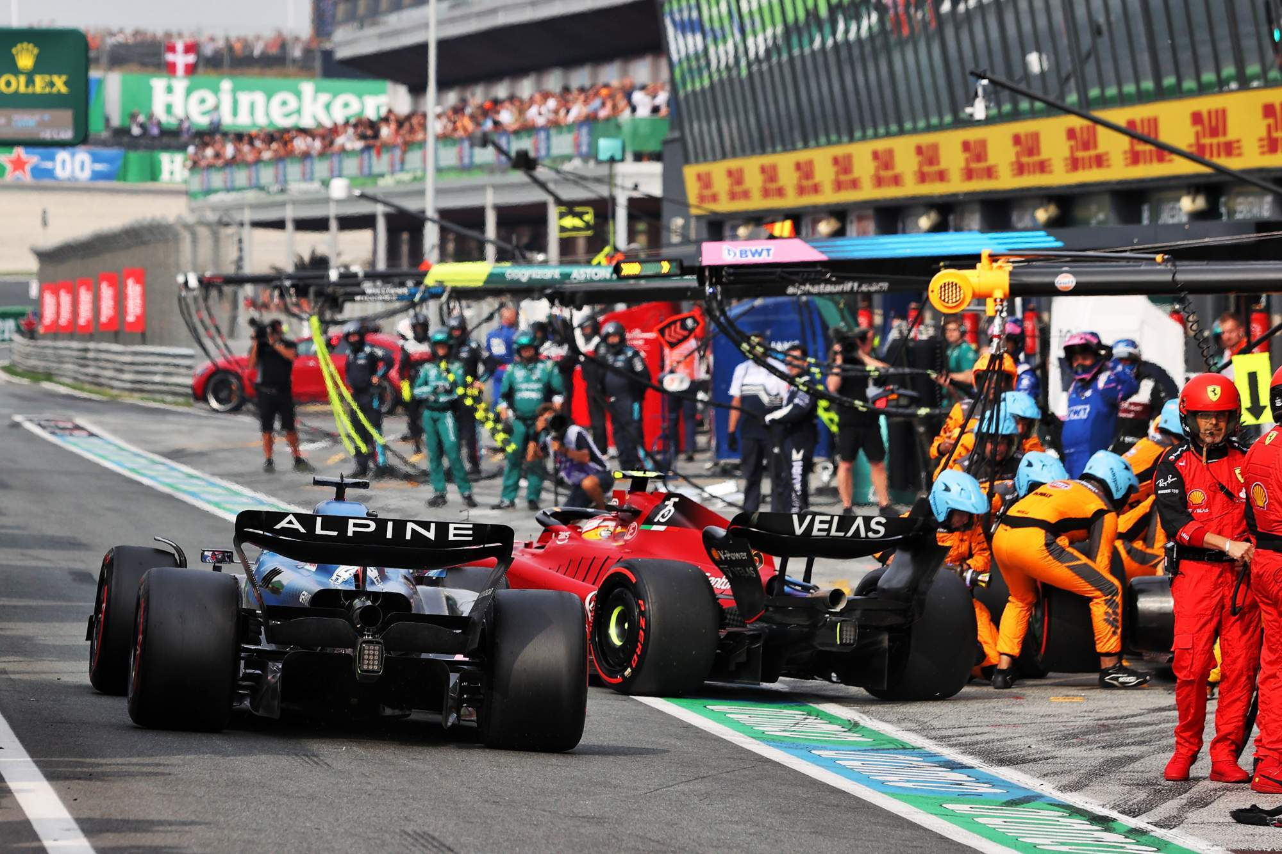

Slide 16
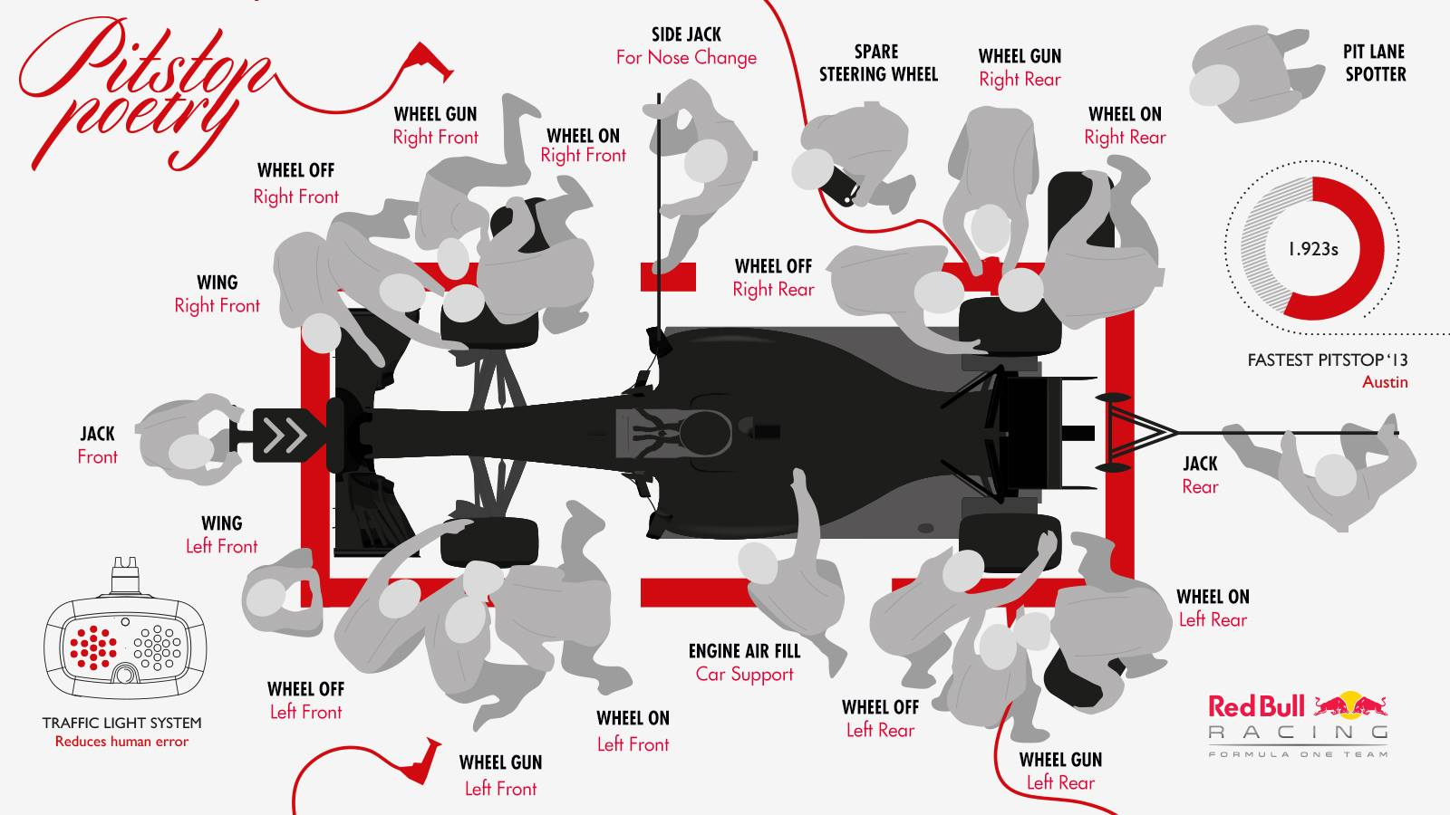

Slide 17
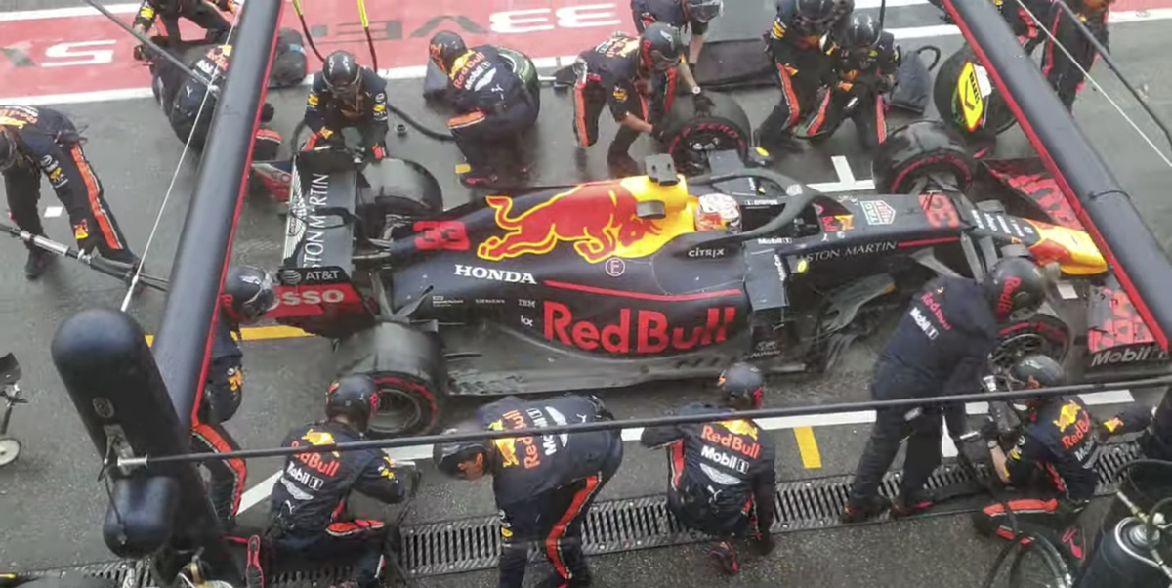
Notes:
https://www.youtube.com/watch?v=stSlnXZ4xnI

Slide 18

Notes:
https://www.youtube.com/watch?v=stSlnXZ4xnI

Slide 19
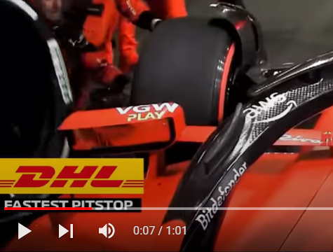
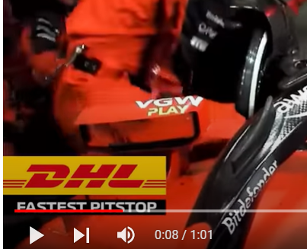

Slide 20
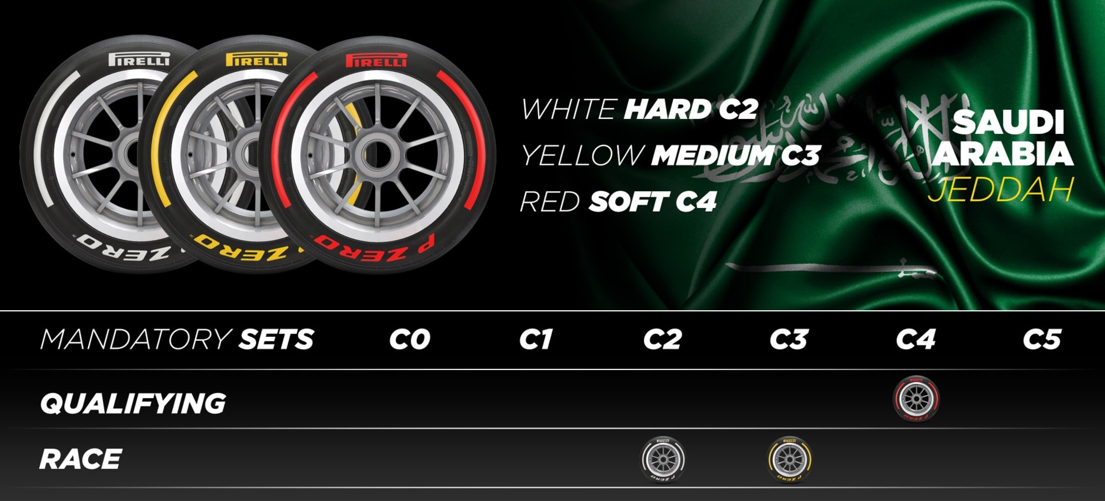
Notes:
https://www.formula1.com/en/latest/article.pirelli-confirm-tyre-choices-for-first-three-f1-races-of-2023-as-new.1xlpcTVaLqw0NeM3aYoyCt.html

Slide 21
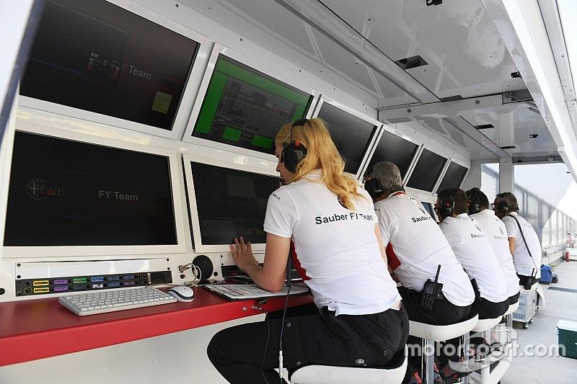

Slide 22
Flags in F1 Races
Flag Color/Type | Meaning
Yellow | Hazard on track.
Green | Normal racing conditions apply.
Red | Session is suspended.
Blue | A faster car is approaching. Move aside (when a driver is being lapped).
Yellow & Red Stripes | Track is slippery.
Black With an Orange Circle | A driver has a mechanical issue and must return to the pits.
Black & White | Warning for unsportsmanlike behavior.
Black | Disqualification.
White | Slower moving vehicles ahead, or miscellaneous vehicles on the track.
Checkered | The session is finished (no new laps may be started).

Slide 23
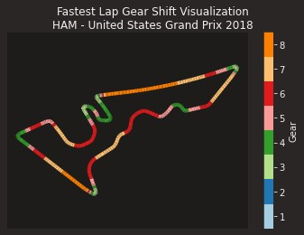
Notes:
Where is the startpoint?
Green in the top left, heading down

Slide 24
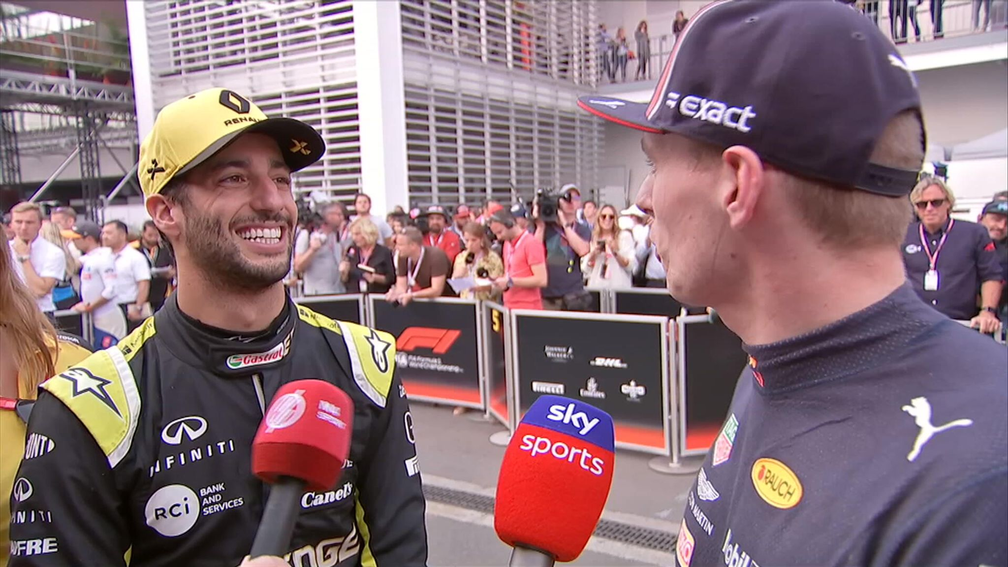
Notes:
I am now ready for questions

Slide 25
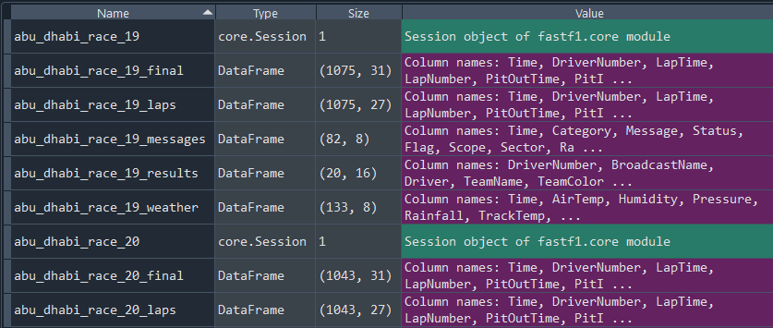

Slide 26
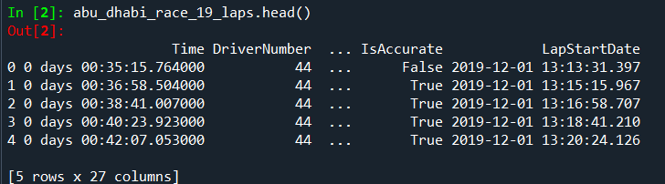
Dataframes: Laps

Slide 27
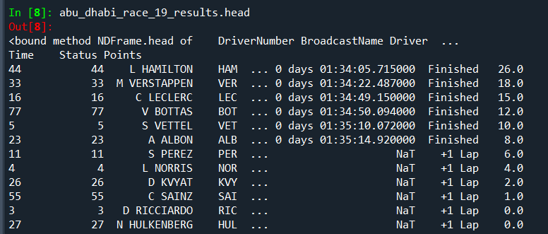
Dataframes: Results

Slide 28
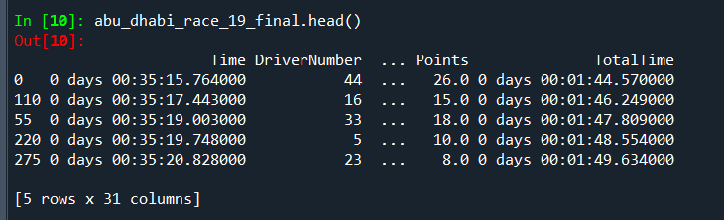
Dataframes: Final
abu_dhabi_race_19_final = pd.merge( abu_dhabi_race_19_laps,
abu_dhabi_race_19_results[[
'Driver', 'GridPosition', 'Position’, 'Points']],
on='Driver’,
how='left')

Slide 29
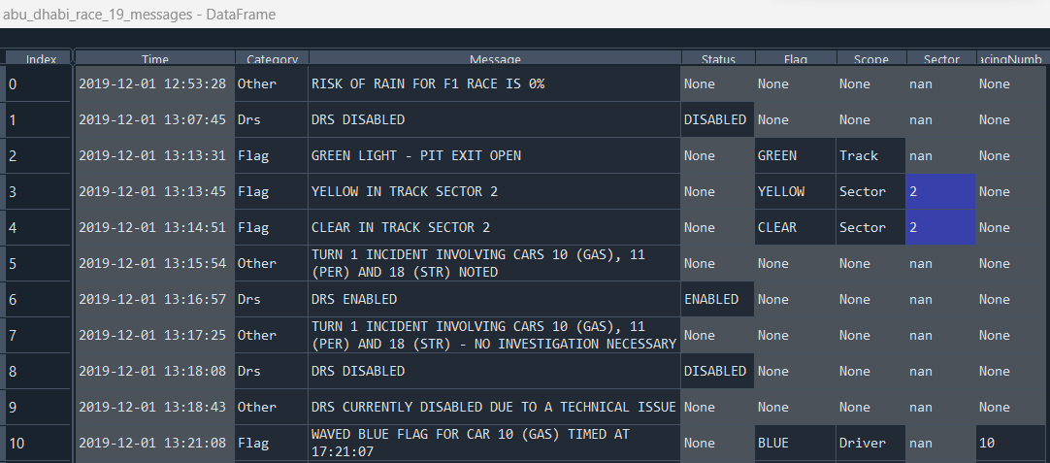
Dataframes: Messages

Slide 30
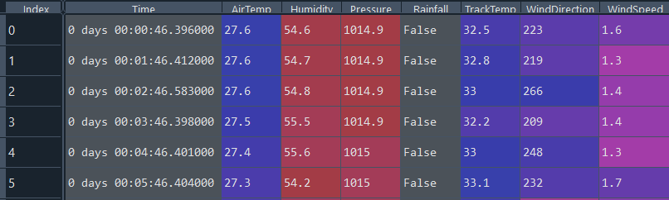
Dataframes: Weather

Slide 31
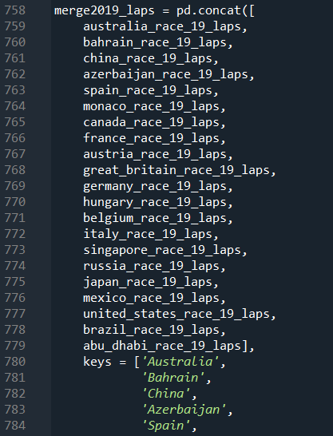
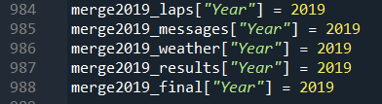
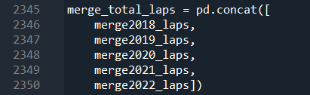
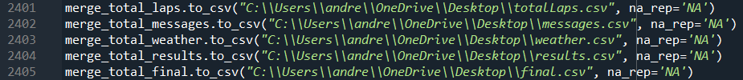
Dataframes: Transformations

Slide 32
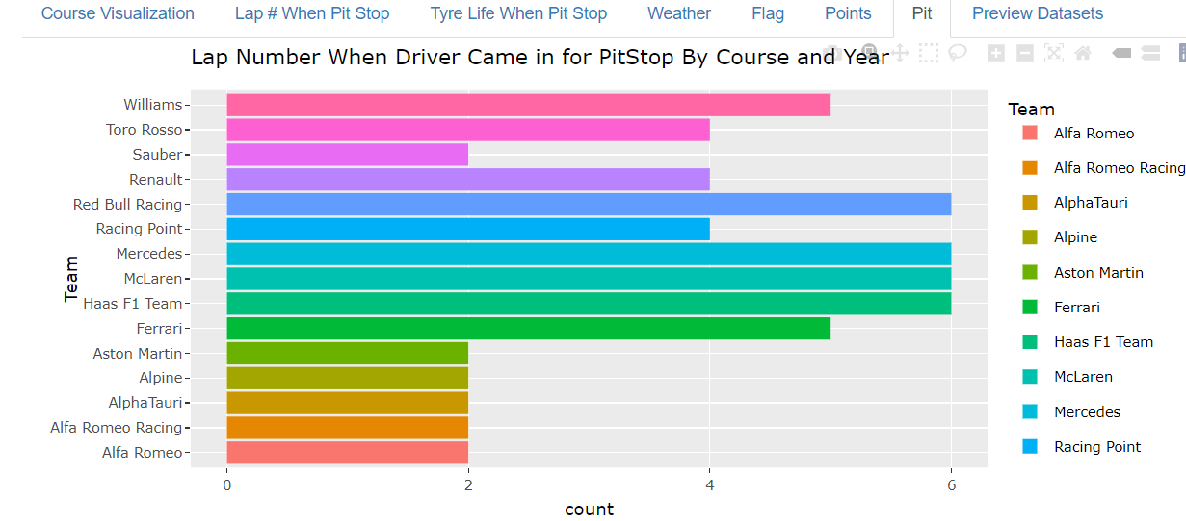
Shiny Visualization

Slide 33
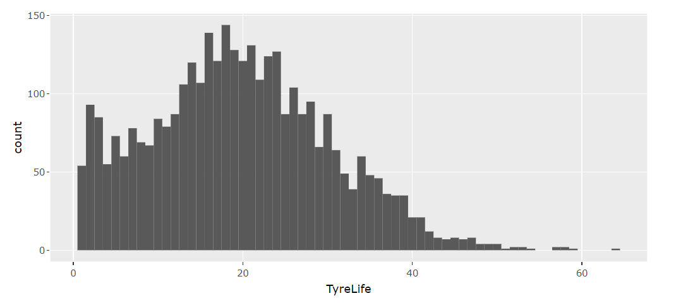
Tire Life When Pit Stop Made

Slide 34
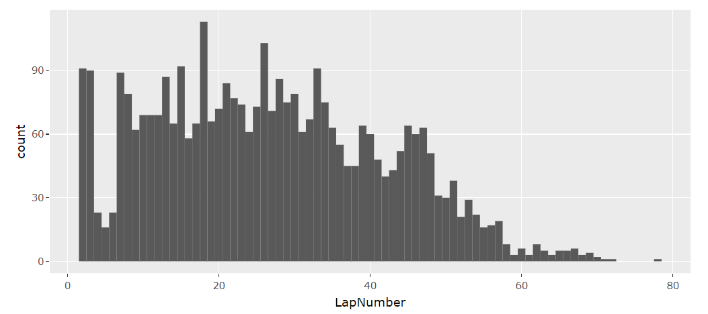
Lap Number When Pit Stop Made

Slide 35

Mean - Lap # When Pit Stop Made
14.833 (Saudi Arabia 2018)
26.847 (all courses)
Variance - Lap # When Pit Stop Made
46.567 (Saudi Arabia 2018)
225.903 (all courses)

Slide 36
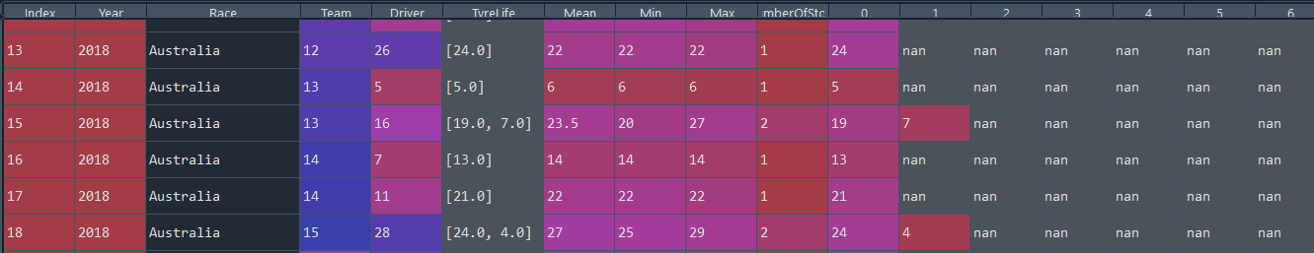
Pit Stop Data Frame

Slide 37
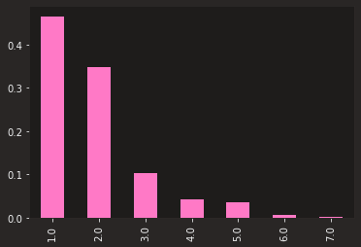
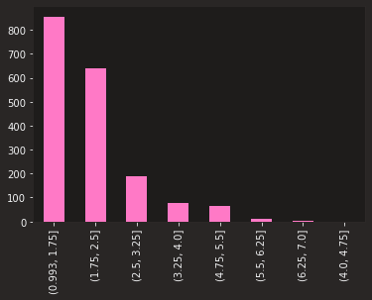
Normalized vs Actual # of Pit Stops Per Race

Slide 38


Slide 39
Variable | Coef | Std Erro | Z | P | 0.025 | 0.975
TyreLife | 0.1357 | 0.002 | 61.849 | 0 | 0.131 | 0.14
Cumulative | 0.0006 | 8.62E-06 | 74.35 | 0 | 0.001 | 0.001
CumulativeLap | 0.001 | 1.31E-05 | 73.849 | 0 | 0.001 | 0.001
CumulativePit | 0.0015 | 2.16E-05 | 68.217 | 0 | 0.001 | 0.002
Sector1TimeSeconds | 0.0372 | 0.001 | 65.751 | 0 | 0.036 | 0.038
Sector2TimeSeconds | 0.05 | 0.001 | 68.866 | 0 | 0.049 | 0.051
Sector3TimeSeconds | 0.0371 | 0.001 | 67.139 | 0 | 0.036 | 0.038
PitTime | 0.0025 | 4.29E-05 | 58.611 | 0 | 0.002 | 0.003
PitOutTimeSeconds | 0 | 0 | nan | nan | 0 | 0
PitInTimeSeconds | 0.0004 | 5.19E-06 | 76.482 | 0 | 0 | 0
Stint | 1.0934 | 0.015 | 72.19 | 0 | 1.064 | 1.123
Gap | 0.0027 | 0 | 13.765 | 0 | 0.002 | 0.003
Fresh Tyre - FALSE | 2.8084 | 0.05 | 56.027 | 0 | 2.71 | 2.907
Fresh Tyre - True | 2.5713 | 0.056 | 45.564 | 0 | 2.461 | 2.682
TeamCat | 0.3661 | 0.007 | 54.139 | 0 | 0.353 | 0.379
DriverCat | 0.1939 | 0.003 | 60.429 | 0 | 0.188 | 0.2
DriverNumberCat | 0.1997 | 0.003 | 59.707 | 0 | 0.193 | 0.206
TrackStatusCat | 0.5792 | 0.01 | 55.519 | 0 | 0.559 | 0.6
Notes:
Poisson

Slide 40
Variable | coef | std err | z | P>|z| | [0.025 | 0.975]
Stint | 1.0922 | 0.031 | 35.145 | 0 | 1.031 | 1.153
Stint_alpha | 1.2417 | 0.216 | 5.747 | 0 | 0.818 | 1.665
TyreLife | 0.1365 | 0.005 | 25.987 | 0 | 0.126 | 0.147
TyreLife_alpha | 1.987 | 0.281 | 7.069 | 0 | 1.436 | 2.538
Sector1TimeSeconds | 0.0374 | 0.001 | 28.658 | 0 | 0.035 | 0.04
Sector1TimeSeconds_alpha | 1.6397 | 0.271 | 6.06 | 0 | 1.109 | 2.17
Sector2TimeSeconds | 0.0506 | 0.001 | 34.544 | 0 | 0.048 | 0.053
Sector2TimeSeconds_alpha | 1.123 | 0.21 | 5.339 | 0 | 0.711 | 1.535
Sector3TimeSeconds | 0.0374 | 0.001 | 30.331 | 0 | 0.035 | 0.04
Sector3TimeSeconds_alpha | 1.4451 | 0.255 | 5.665 | 0 | 0.945 | 1.945
DriverCat | 0.1984 | 0.008 | 25.492 | 0 | 0.183 | 0.214
DriverCat_alpha | 1.8954 | 0.291 | 6.504 | 0 | 1.324 | 2.467
DriverNumberCat | 0.2015 | 0.008 | 24.005 | 0 | 0.185 | 0.218
DriverNumberCat_alpha | 2.0324 | 0.312 | 6.513 | 0 | 1.421 | 2.644
TeamCat | 0.3762 | 0.017 | 21.984 | 0 | 0.343 | 0.41
TeamCat_alpha | 2.2141 | 0.334 | 6.636 | 0 | 1.56 | 2.868
FreshTyreFalse | 2.7766 | 0.073 | 38.12 | 0 | 2.634 | 2.919
FreshTyreTrue | 2.6103 | 0.079 | 33.005 | 0 | 2.455 | 2.765
FreshTyre_alpha | 0.4366 | 0.137 | 3.191 | 0.001 | 0.168 | 0.705
Notes:
Consul’s Poisson

Slide 41
Famoye

Slide 42
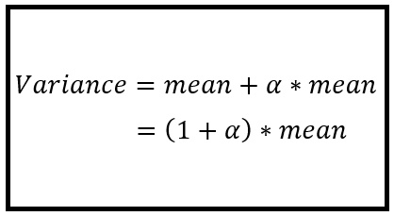
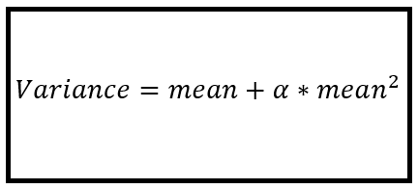
Negative Binomial: Which Model
Notes:
https://timeseriesreasoning.com/contents/negative-binomial-regression-model/
http://faculty.econ.ucdavis.edu/faculty/cameron/racd2/

Slide 43
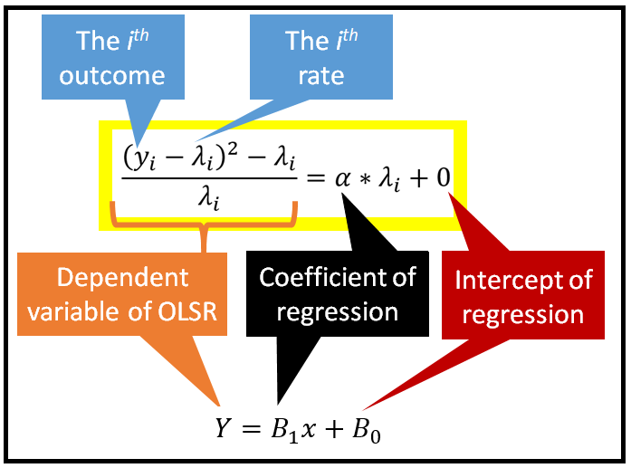
Negative Binomial 2
Notes:
https://timeseriesreasoning.com/contents/negative-binomial-regression-model/
http://faculty.econ.ucdavis.edu/faculty/cameron/racd2/

Slide 44

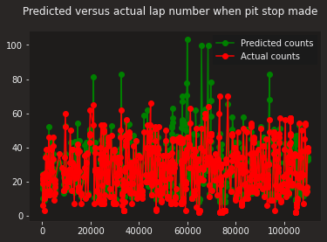
Notes:
https://www.npr.org/2023/01/16/1149232763/this-is-fine-meme-anniversary-gunshow-web-comic

Slide 46
Variable | Importance
Sector1TimeSeconds' | 9.421%.
CumulativeLap' | 8.47%.
Sector2TimeSeconds' | 6.959%.
Sector3TimeSeconds' | 6.898%.
CumulativePit' | 5.435%.
TyreLife' | 4.298%.
EndPosition' | 2.19%.
TrackStatusCat' | 16.64%.
Cumulative' | 11.057%.
PitTime' | 10.172%.
PitInTimeSeconds' | 10.074%.
DriverCat' | 1.543%.
Gap' | 1.23%.
Points' | 1.067%.
Stint' | 1.043%.
Notes:
Random Forest

Slide 47



Quasi-Poisson and Others
Notes:
https://cran.r-project.org/web/packages/pscl/vignettes/countreg.pdf
https://flexmix.nl/
https://stock.adobe.com/search?k=gee
https://www.google.com/imgres?imgurl=https%3A%2F%2Fwww.abbreviations.com%2Fimages%2F1686210_NLME.png&tbnid=xr2qAERW6FHBuM&vet=12ahUKEwjY39ilkub_AhXwhbAFHR3EA-EQMygBegUIARC_AQ..i&imgrefurl=https%3A%2F%2Fwww.abbreviations.com%2FNLME&docid=ma_2annBzs_ZyM&w=500&h=270&itg=1&q=nlme%20word&ved=2ahUKEwjY39ilkub_AhXwhbAFHR3EA-EQMygBegUIARC_AQ

Slide 48
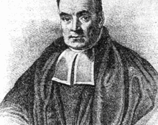
Bayesian Analysis
Simulate the Normal model
Posterior predictive check
Check predictive power
Simulate posterior predictive models
Plot the posterior predictive models
Summarize Cross Validated Model
Notes:
https://cran.r-project.org/web/packages/pscl/vignettes/countreg.pdf
https://flexmix.nl/
https://stock.adobe.com/search?k=gee
https://www.google.com/imgres?imgurl=https%3A%2F%2Fwww.abbreviations.com%2Fimages%2F1686210_NLME.png&tbnid=xr2qAERW6FHBuM&vet=12ahUKEwjY39ilkub_AhXwhbAFHR3EA-EQMygBegUIARC_AQ..i&imgrefurl=https%3A%2F%2Fwww.abbreviations.com%2FNLME&docid=ma_2annBzs_ZyM&w=500&h=270&itg=1&q=nlme%20word&ved=2ahUKEwjY39ilkub_AhXwhbAFHR3EA-EQMygBegUIARC_AQ

Slide 49
Notes:
I am now ready for questions

